Slide 1

MACHINE LEARNING PRESENTATION
NAME : V.Balaiah
BRANCH: ECE
ROLL NO: 20781A04J3

Slide 2
What is machine learnning ?
Machine learning is an application of artefical intillgence (AI) that provides systems the ability to automatically learn and improvie from experience without being explicitly programmed
Machine learning focuses on the development that can access data and use it to learn for themselves

Slide 3
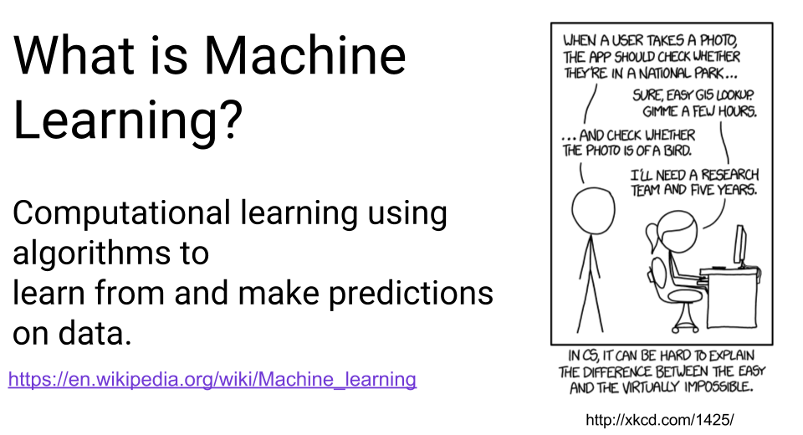

Slide 4
Why machine learning is important?
Machine learning is the core subarea of arteficial intelligance. It makes computers get into a self-learning mode without explicit programming.
When fed new data, these computers learn,grow, change, and deveiop by themselves.
The iterative aspect of machine learning is important because as modeles are exposed to new data, they are able to independently adapt. They learn from previousbcomputation to produce reliable, repeatable decisions and results.

Slide 5
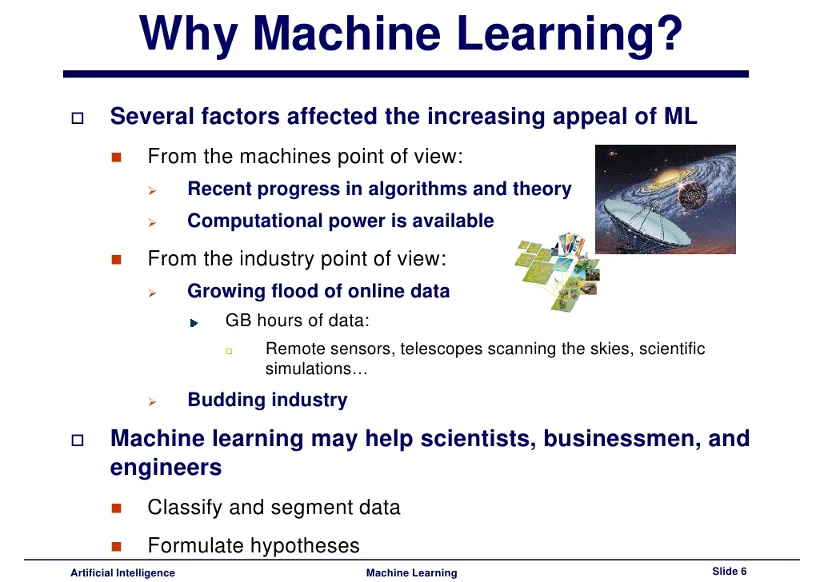

Slide 6
How does machine learning works ?
Machine learning is a form of artefical intelligance (AI) that teachs in a similar way to how humans do:
Learning and improving upon past experiences.
It works by exploring data, identifying patterns, and involves minimal human intervention.

Slide 7
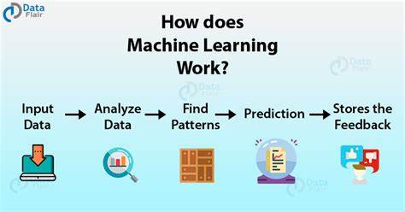

Slide 8
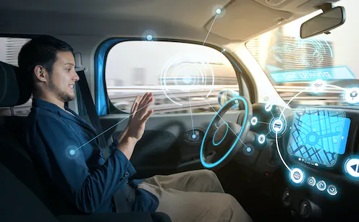
Machine learning algorithms make autonomous vehicales capable of marking decisions in real time. This increasses safety and trust in autonomous cars

Slide 9
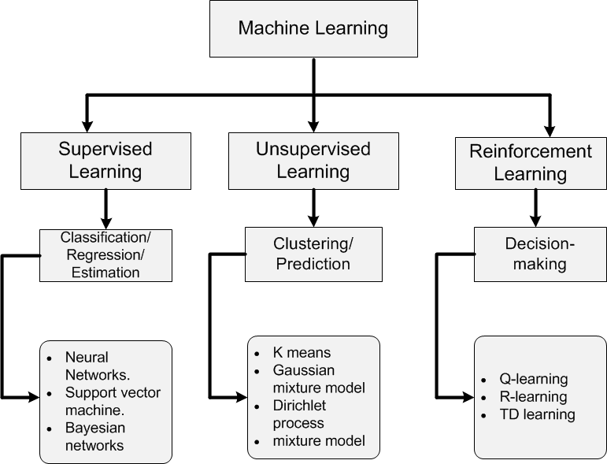

Slide 10
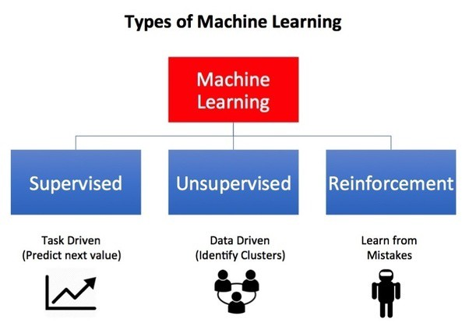

Slide 12
1.Supervised Learning
Supervised learning is one of the most basic types of machine lrarning. In this type, the machine learning algorithm is trained on labeled data. Even through the data needs to be labeled accurately for this method to work, supervised learning is extermely when used in the right aircumstances.
Great examples of supervised learning is text classification problems. In this set of problems, the goal is to predict the class label of a given piece of text. One particular popular topice in text classification is to predict the sentiment of a piece of text, like atweet or a product review.

Slide 13
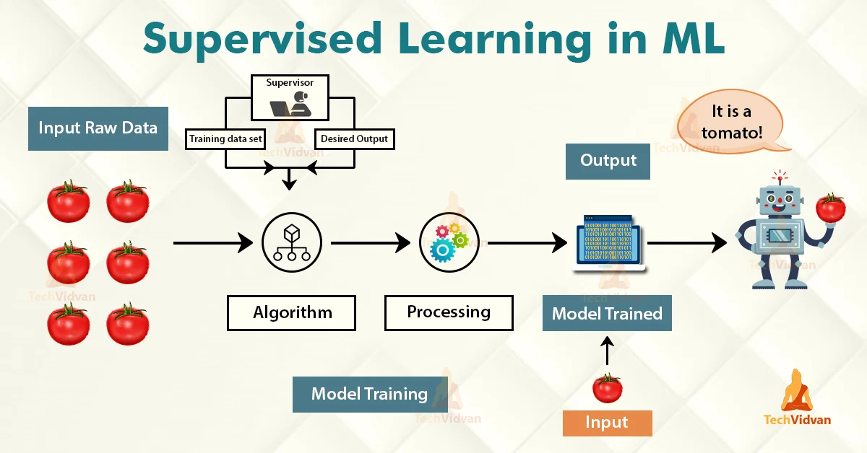

Slide 14
2.unsupervised learning l
Unsupervised learning is a type of machine learning algorithm used to draw inference from datasets consisting of input data without labeled responses. The most common unsupervised learning method is cluster analysis, which is used for exploratory data analysis to find hidden pattern or grouping in data
The Benefit of unsupervised learning is unsupervised learning draws inference from datasets without labels. It is best used if you want to find patterns but don’t know exactly what you're lokking for. This makes it useful in cyber security where the attacker is always changing methods.

Slide 15
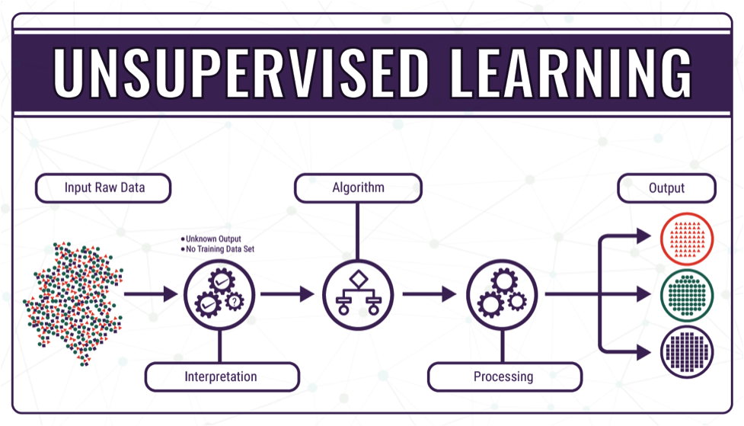

Slide 16
3.reinforcement learning
Reinforc paradigms , aement learning (RL) is an area of machine lrarning conncerned with how software agents ought to take actions in an environment in order to maximize the notion of cumulative reward. Reinforcement learning is one of three basic machine learning paradigm, alongside supervised learning and unsupervised learning.
Reinforcement learning is a type of Machine learning algorithm which allows software agents and machines to automatically determine to ideal behavior within a specific context, to maximize its performance.

Slide 17
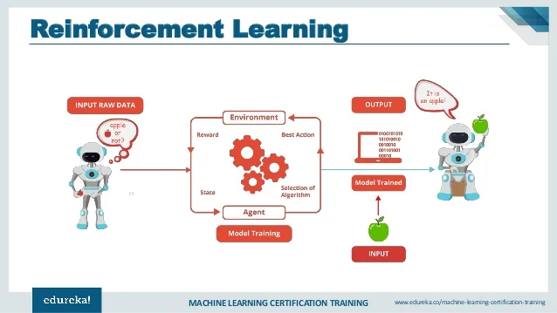

Slide 18
DEEP LEARNING
Deep learning is an artefical intelligence (AL)
Function that imitates the working of the human brain in processing data and creating patterns for use in decision making. Deep learning is a subset of machine learning in artifical intelligence that has networks capable of learning unsupervised from data that is unstaructured or unabeled .also know as deep neural learning or deep neural networking.
Deep learning is aclass of machine learning algorithms that uses multiple layers to progressively extract higher-level features from the raw input. For example,in image processing , lower layers may identify edgs, while higher layers may identify the concepts relevant to a human such as digits or letters or faces

Slide 19
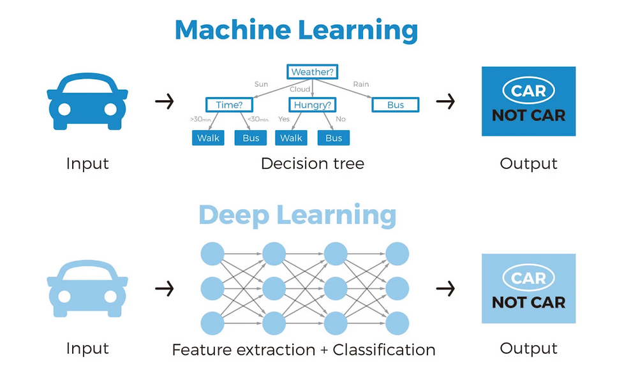
MACHINE LEARNING V/S DEEP LEARNING
The differences between the two :Machine learning uses algorithms to parse data ,learn form that data, and make informed decisions based on what it has learned. Deep learning structures algorithms in layers to create an "artefical neural network " that can learn and make intelligent decisions on its own

Slide 20
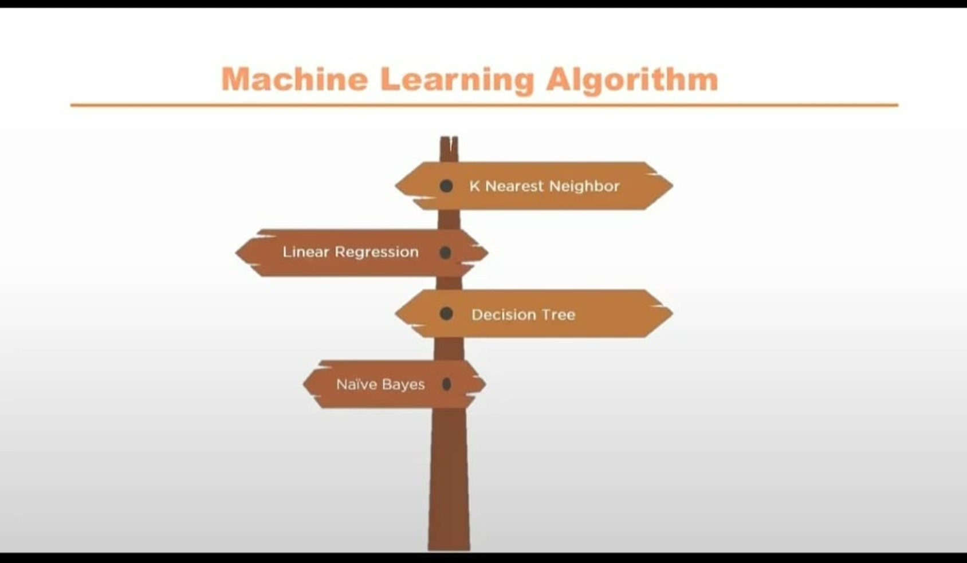

Slide 21
KNEAREST NEIGHBOR ALGORITHM
Knearest Neighbour is one of the simplest Machine Learning algorithms based on Supervised Learning technique.
•K-NN algorithm assumes the similarity between the new case/data and available cases and put the new case into the category that is most similar to the available categories.
•K-NN algorithm can be used for Regression as well as for Classification but mostly it is used the Classification problems.
•K-NN is a non-parametric algorithm, which means it does not make any assumption on underlying data.
rvised Learning technique.

Slide 22
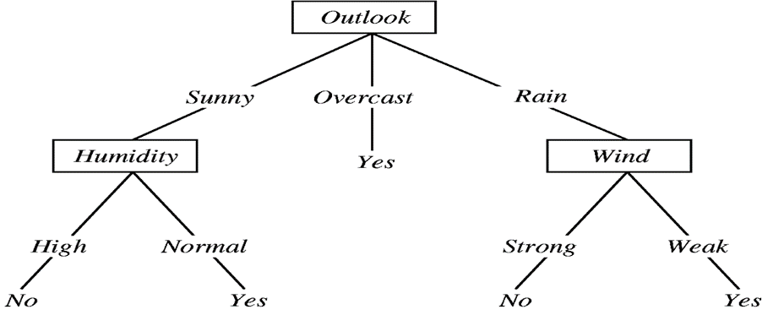
DECISION TREE ALGORITHM
•Decision tree algorithm falls under the category of supervised learning. They can be used to solve both regression and classification problems.
•Decision tree uses the tree representation to solve the problem in which each leaf node corresponds to a class label and attributes are represented on the internal node of the tree.
•We can represent any boolean function on discrete attributes using the decision tree.

Slide 23
NAVIE BAYES ALGORITHM
Naïve: It is called Naïve because it assumes that the occurrence of a certain feature is independent of the occurrence of other features
•Bayes: It is called Bayes because it depends on the principle of 'Bayes' .
•Some popular examples of Naïve Bayes Algorithm are spam filtration, Sentimental analysis, and classifying articles.

Slide 24
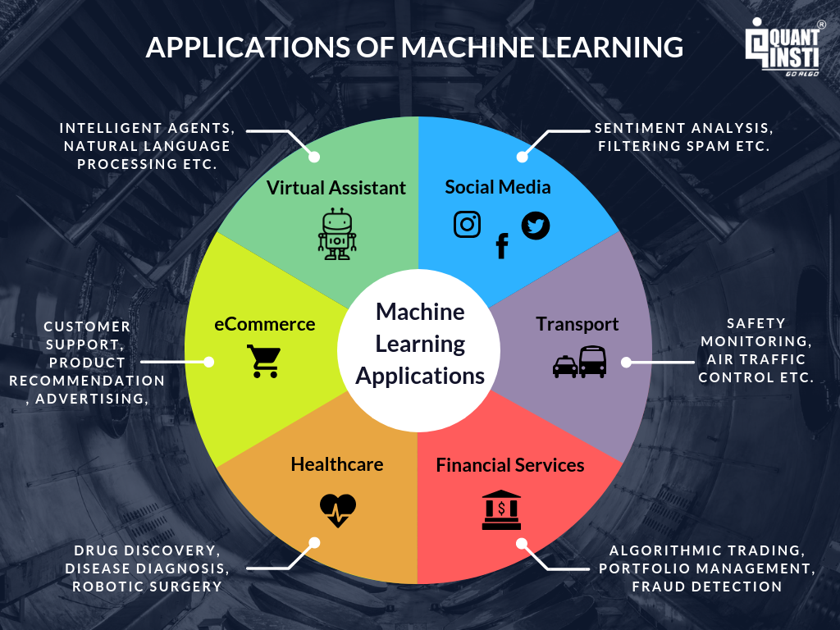

Slide 28
THANK YOU

